Slide 1
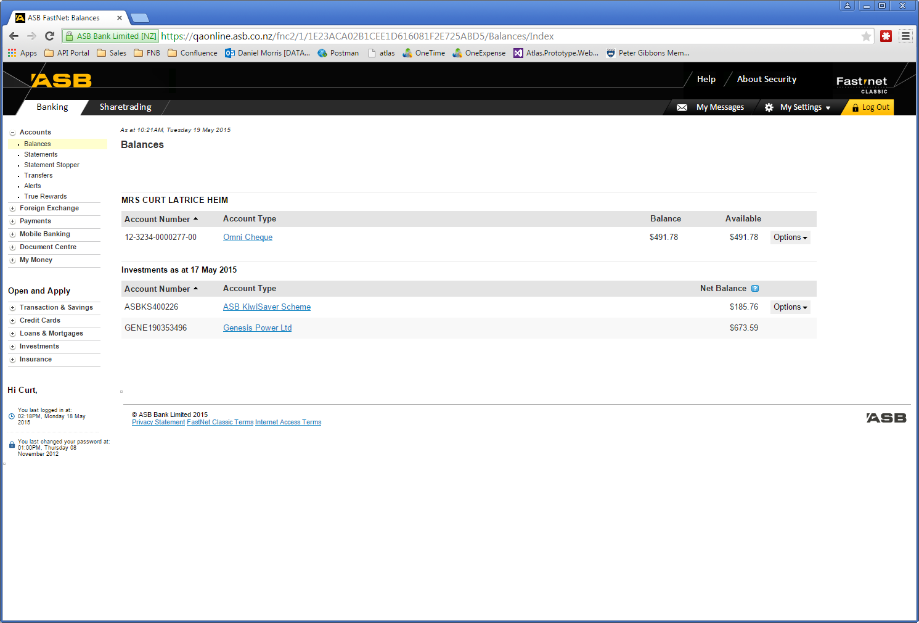
Fastnet Classic

Slide 2


True Rewards
Notes:
Visa Business Rewards
Business True Rewards

Slide 3
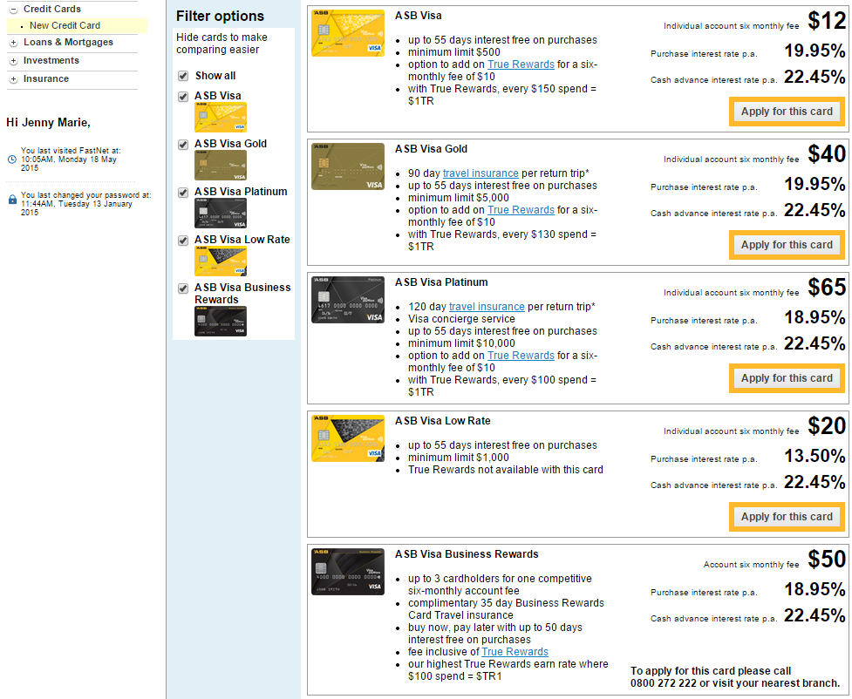

Slide 4
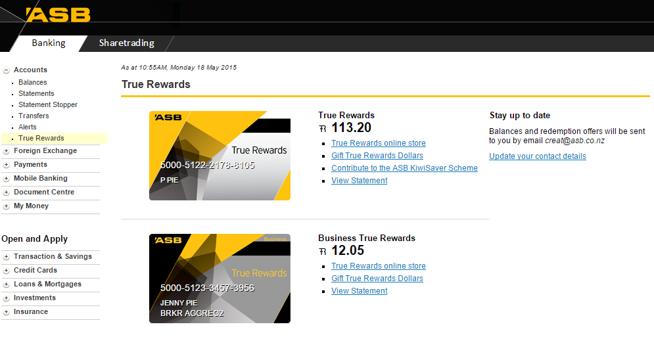

Slide 5


Digital Acceptance
Notes:
Digital acceptance for loan documentation, enabling STP loan advances.

Slide 6
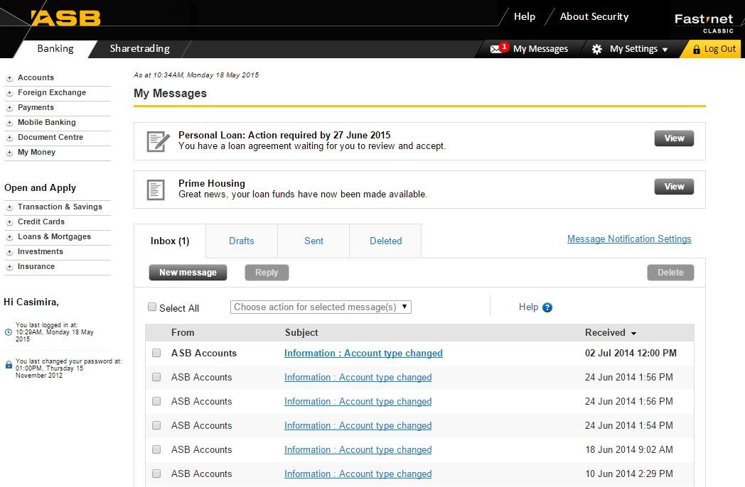

Slide 7
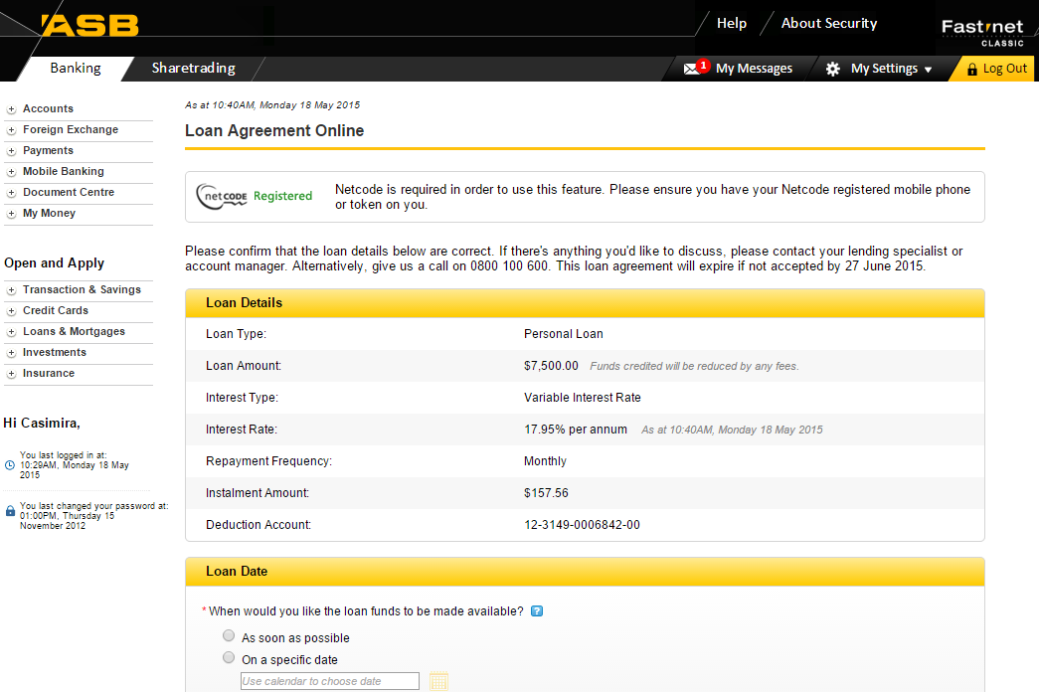

Slide 8
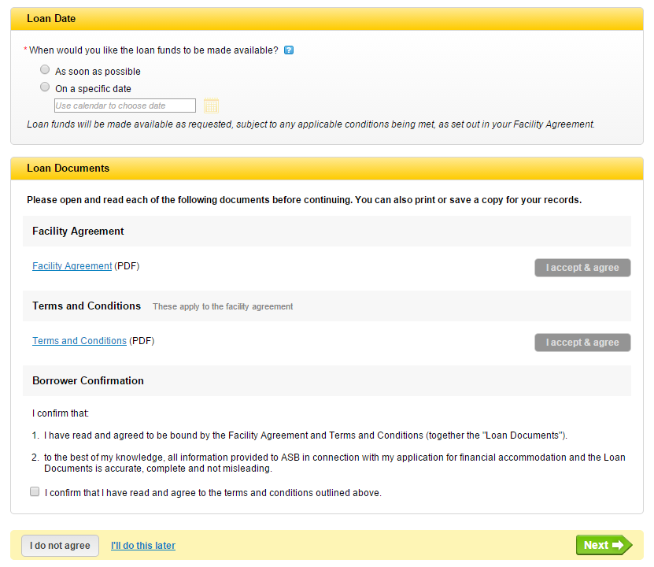

Slide 9


Online Share Trading
Notes:
2 new markets (NZAX and ETFs) to Online Share trading.
Previously, these 2 markets could only be traded on by phoning ASB Securities.

Slide 10
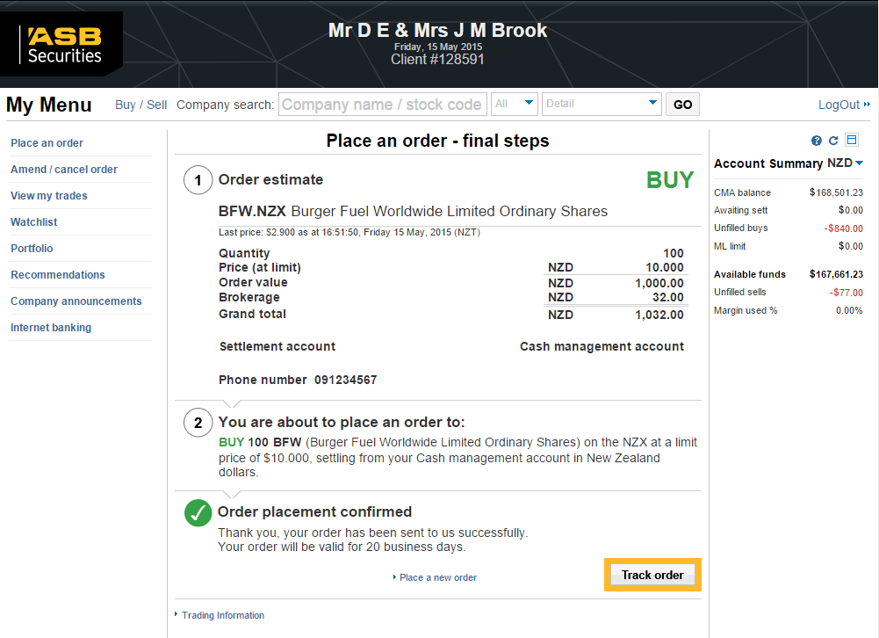

Slide 11



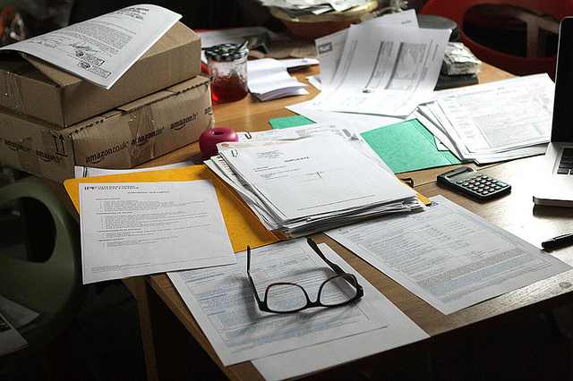
Pre-assessment Limit (PALs2)
Notes:
Individual Orbit Home Loan PALs across the FNC and Onyx channels.

Slide 12
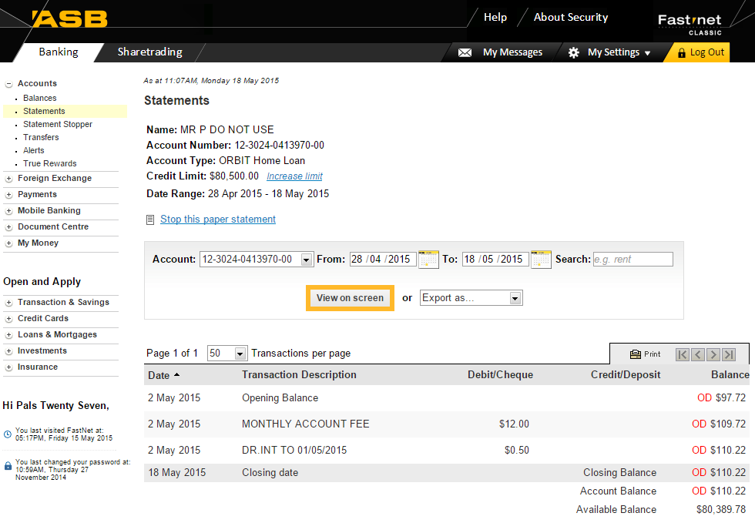

Slide 13
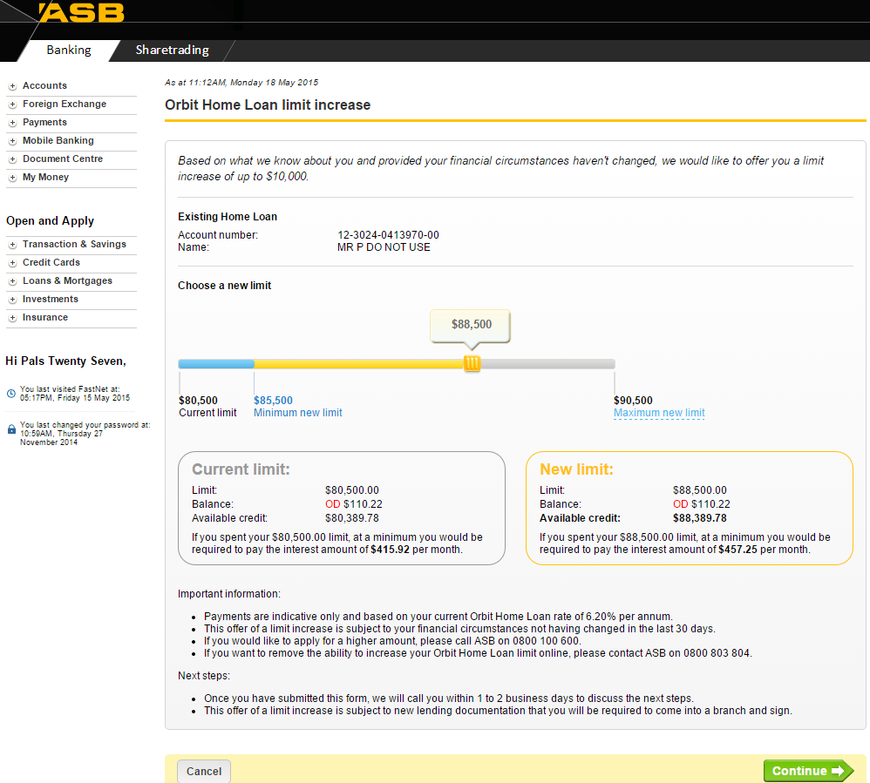

Slide 14
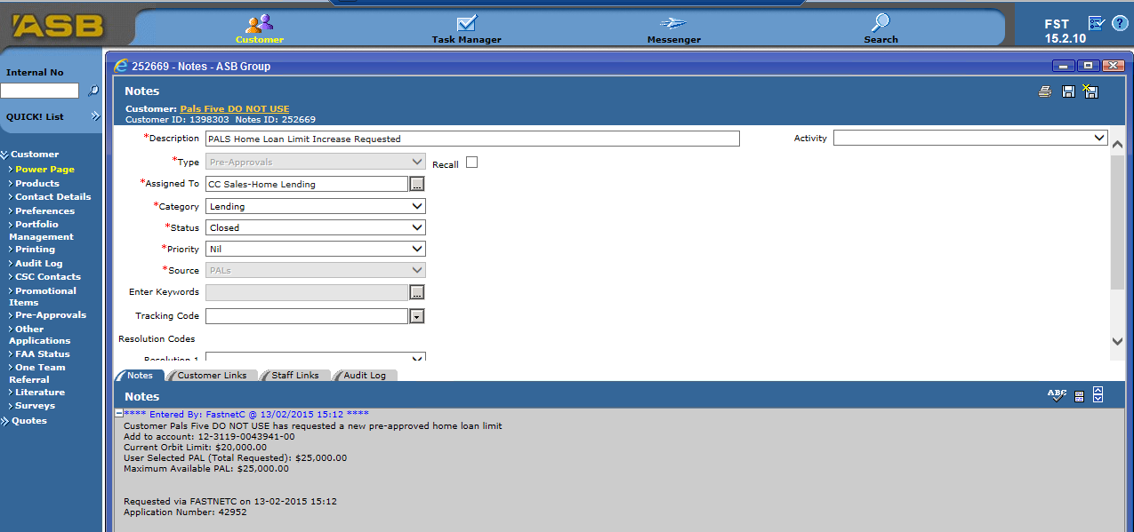

Slide 15
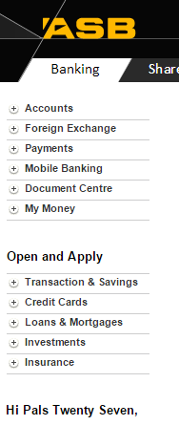

Left Hand Menu
Notes:
FNC left menu enhancements to better surface sales opportunities and digital sales capability

Slide 16


Site Catalyst
Notes:
Links Tracking on the Balances page
Application Forms Tracking under Open and Apply

Slide 17
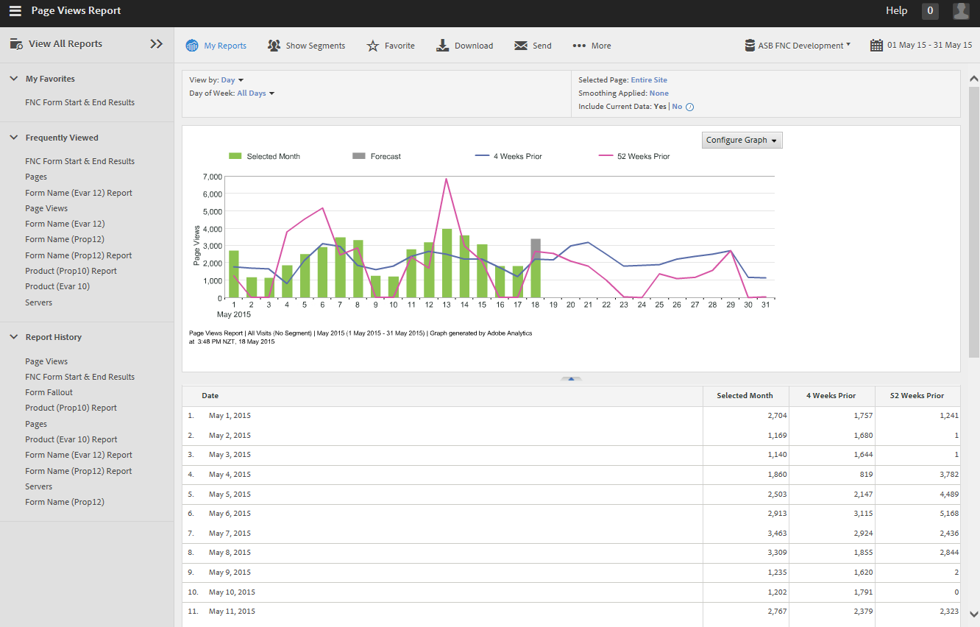

Slide 18

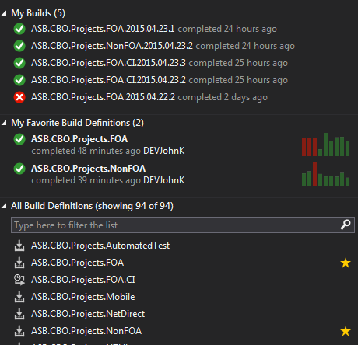
Automation Build
Notes:
Automated build and deploy process for FNC builds
TFS & Octopus

